Slide 1

Parse Trees
--Sakshi Surve

Slide 2
Basics of Grammar :
A language is set of strings over a set of symbols
Language --- Finite set of sentences
Sentence --- Finite set of words
Words --- Finite set of Alphabets / Symbols
Grammar is essential to give syntactical structure to the language
Grammar is the set of rules used to describe string of Language
The language may be Programming language or natural language …Any type will require grammar

Slide 3
Alphabets
Words
Grammar
Sentences

Slide 4
Example :
If we want English statement “Dog Runs” ….We may use following rules :
<Sentence> → <Noun> <Verb>
<Noun> → Dog
< Verb > → Runs
<Sentence> → <Noun> <Verb>
→ Dog Runs
These rules indicate how the sentence of the form ‘Noun’ followed by ‘Verb’ can be generated.
There are many such rules of the language and they are collectively called the Grammar for the language

Slide 5
Constituents of Grammar :
Two Symbols :
Terminals
Non Terminals
Terminals are part of the generated sentence
E.g. In the above example, ‘Dog’ and ‘Runs’ are terminal symbols as they collectively formulate the statement and are part of the statement

Slide 6
Non Terminals take part in the formation of the statement , but are not part of the generated sentence.
No statement that is generated using grammar will contain Non Terminals in it.
E.g. In above example , ‘Sentence’ , ‘Noun’ , ‘Verb’ are Non-terminals…which are not in the generated statement but took part on the formation of the statement
<Sentence> → <Noun> <Verb>
→ Dog Runs
Thus, Non-terminals are essential while declaring the rules
These rules are called as ‘Productions’ or ‘Production Rules’

Slide 7
Formal Definition :
Like a natural language has Constituents like Nouns, Verbs, Adjectives etc….
Two Constituents :
Terminals
Non terminals
This grammar that is based on Constituent structure is called Constituent Structure Grammar Or Phrase Structure Grammar
The idea is …Basing a grammar on Constituent structure blocks
The grammar G will generate language L

Slide 8
Summary :
If we want English statement “Dog Runs” ….We may use following rules :
<Sentence> → <Noun> <Verb>
<Noun> → Dog
< Verb > → Runs
We have to begin with rule ….<Sentence> → <Noun> <Verb>
Start Symbol ……………..Sentence
Non Terminals…..Sentence, Noun, Verb
Terminals…….Dog ,Runs
Rules……indicating how the sentence can be generated.

Slide 9
Grammar :
A Grammar G is a four tuple collection G = (V, T, P, S) ….Where
V is the (finite) set of variables or Non terminals ….They take part in the derivation , but are not part of the derived sentence
T is a finite set of Terminals, i.e., the symbols that form the strings of the language being defined
P is a finite set of Production Rules
S is the Start Symbol (One of the Non terminals )

Slide 10
In the example before :
S = Sentence
V = { Noun , Verb}
T = {Dog , Runs }
P
<Sentence> → <Noun> <Verb>
<Noun> → Dog
< Verb > → Runs

Slide 11
Example :
G = { S, V, P, T }
T = { Man, Book, Reads, The }
V = { N, V ,A}
S = S
P
S → ANVN
A → A | An | The
N → Man | Book
V → Reads
Derive string “ The Man Reads Book”

Slide 12
Derivation ….
S → ANVN
A → A | An | The
N → Man | Book
V → Reads
The Man Reads Book
S→ ANVN
→The NVN
→ The Man VN
→ The Man Reads N
→ The Man Reads Book
Leftmost Derivation

Slide 13
Derivation ….
S → ANVN
A → A | An | The
N → Man | Book
V → Reads
The Man Reads Book
S→ ANVN
→ ANV Book
→ AN Reads Book
→ A Man Reads Book
→ The Man Reads Book
Rightmost Derivation

Slide 14
∑ = { a , b }
L = { w € L | w begins with a }
L = { a , aa, ab, aab, aba, aaa, ………}
S -> aA
A -> aA | bA | €
For ‘a’
S
a A
€
Derivation of ‘a’
S →aA
→a

Slide 15
S -> aA A -> aA | bA | €
For generating ‘aa’
S
a A
a A
€
Derivation of ‘aa’
S →aA
→aaA
→aa

Slide 16
S -> aA A -> aA | bA | €
Derivation of ‘aba’
S →aA
→abA
→abaA
→aba
For generating ‘aba’
S
a A
b A
a A
€
In this grammar, the tuples are :
V = {S, A}
T = { a,b }
P
S = S

Slide 17
Parser :
Parser is a component of a Compiler or Interpreter that breaks data into smaller elements
Parser takes the input in the form of a sequence of tokens and builds a data structure in the form of a tree called Parse tree
Deriving a Syntactic tree like structure from the stream of tokens is called Parsing
Parsing is a process of determining if a string of tokens can be generated by a grammar

Slide 18
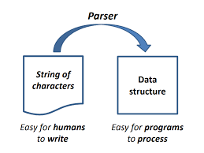

Slide 19
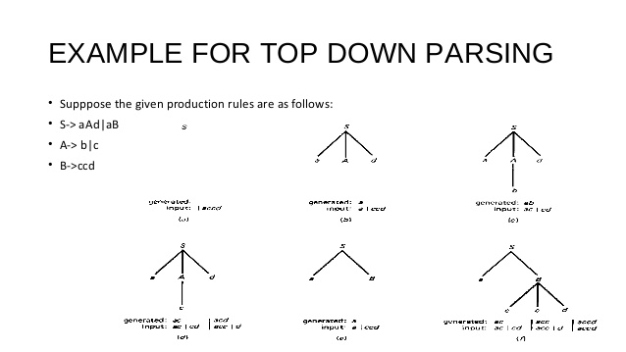

Slide 20
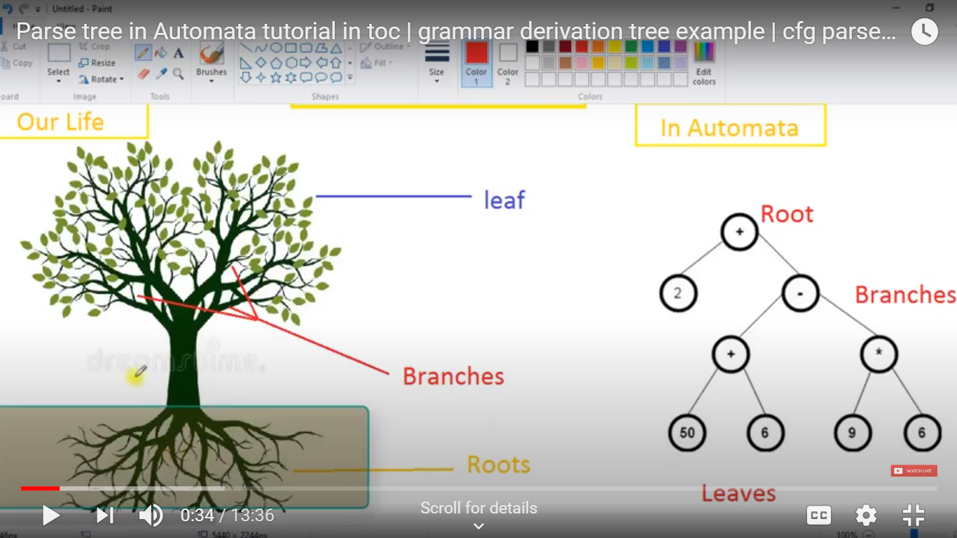

Slide 21
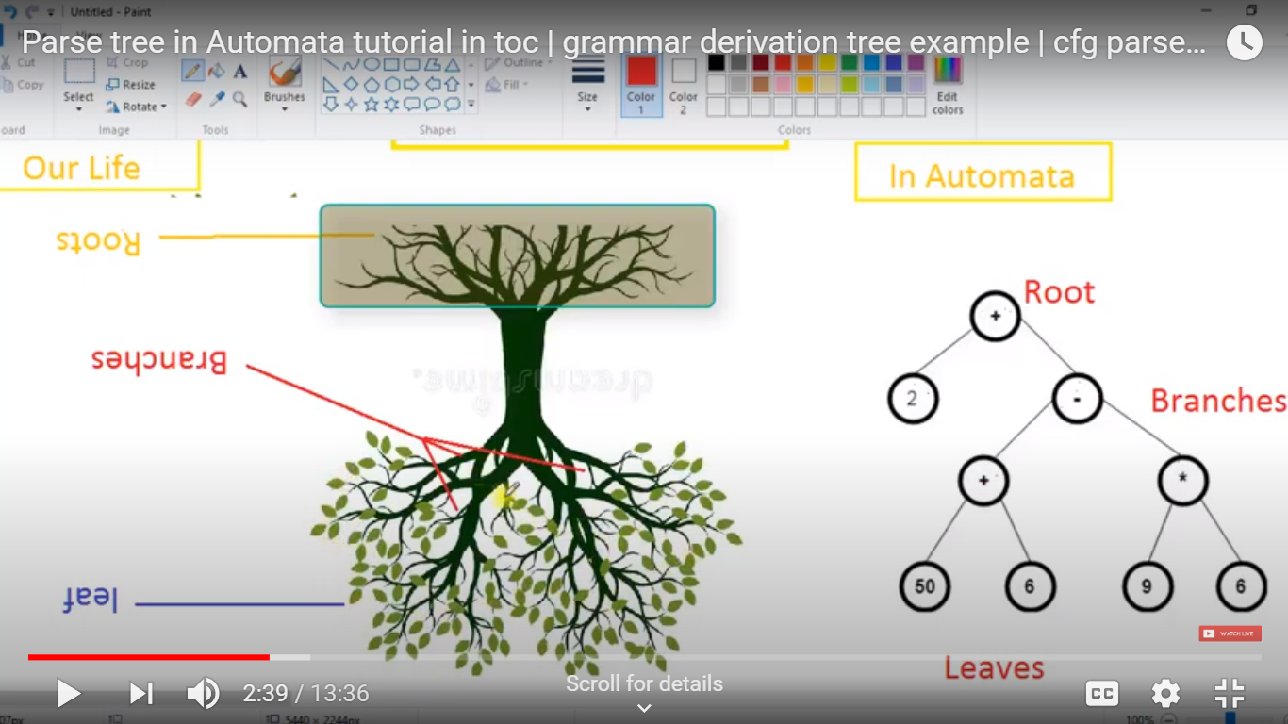

Slide 22
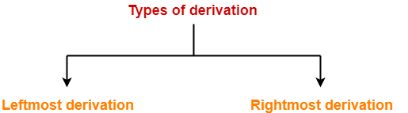
Parse Tree :
The process of deriving a string using grammar rules is called as derivation.
The geometrical representation of a derivation is called as a parse tree or derivation tree.

Slide 23
Leftmost Derivation
The process of deriving a string by expanding the leftmost non-terminal at each step is called as leftmost derivation.
The geometrical representation of leftmost derivation is called as a leftmost derivation tree.

Slide 24
Example 1 :
Consider the following example :
S → aB / bA
A → aS / bAA / a
B → bS / aBB / b
Let us consider a string
w = aaabbabbba
Now, let us derive the string w using leftmost derivation.

Slide 25
Leftmost Derivation -
S → aB / bA
A → aS / bAA / a
B → bS / aBB / b
aaabbabbba
S → aB
→ aaBB (Using B → aBB)
→ aaaBBB (Using B → aBB)
→ aaabBB (Using B → b)
→ aaabbB (Using B → b)
→ aaabbaBB (Using B → aBB)
→ aaabbabB (Using B → b)
→ aaabbabbS (Using B → bS)
→ aaabbabbbA (Using S → bA)
→ aaabbabbba (Using A → a)

Slide 26
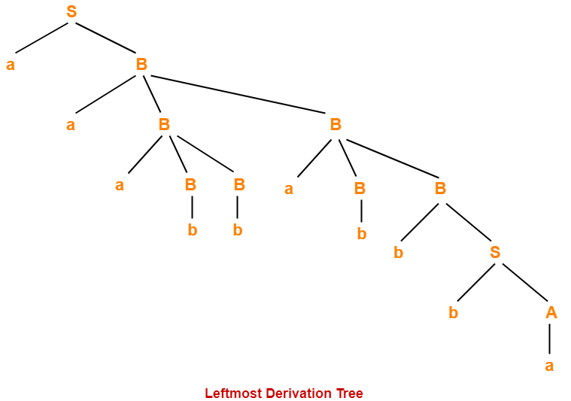

Slide 27
Rightmost Derivation.
The process of deriving a string by expanding the rightmost non-terminal at each step is called as rightmost derivation.
The geometrical representation of rightmost derivation is called as a rightmost derivation tree.

Slide 28
Example 1 :
Consider the following grammar-
S → aB / bA
S → aS / bAA / a
B → bS / aBB / b
Let us consider a string w = aaabbabbba
Now, let us derive the string w using rightmost derivation.

Slide 29
Rightmost Derivation-
S → aB / bA
A → aS / bAA / a
B → bS / aBB / b
aaabbabbba
S → aB
→ ab (Using B → b)
This is NOT what we want …………….

Slide 30
Rightmost Derivation-
S → aB / bA
A → aS / bAA / a
B → bS / aBB / b
aaabbabbba
S → aB
→ a bS (Using B → bS)
→ abbA (Using S → bA)
→ abba (Using A → a)
This is NOT what we want …………….

Slide 31
Rightmost Derivation-
S → aB / bA
A → aS / bAA / a
B → bS / aBB / b
aaabbabbba
S → aB
→ aaBB (Using B → aBB)
→ aaBbS (Using B → bS)
→ aaBbbA (Using S → bA)
→ aaBbba (Using A → a )
→ aaaBBbba (Using B → aBB)
→ aaaBbbba (Using B → b )
→ aaabSbbba (Using B → bS)
→ aaabbAbbba (Using S → bA)
→ aaabbaSbbba (Using A → aS)
This is NOT what we want …………….

Slide 32
Rightmost Derivation-
S → aB / bA
A → aS / bAA / a
B → bS / aBB / b
aaabbabbba
S → aB
→ aaBB (Using B → aBB)
→ aaBaBB (Using B → aBB)
→ aaBaBbS (Using B → bS)
→ aaBaBbbA (Using S → bA)
→ aaBaBbba (Using A → a)
→ aaBabbba (Using B → b)
→ aaaBBabbba (Using B → aBB)
→ aaaBbabbba (Using B → b)
→ aaabbabbba (Using B → b)

Slide 33
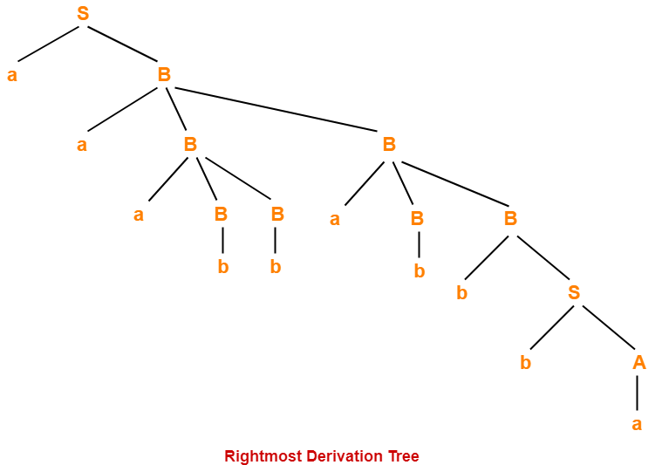

Slide 34
Parse Tree :
Properties Of Parse Tree-
Root node of a parse tree is the start symbol of the grammar.
Each leaf node of a parse tree represents a terminal symbol.
Each interior node of a parse tree represents a non-terminal symbol.
Parse tree is independent of the order in which the productions are used during derivations.
Yield Of Parse Tree-
Concatenating the leaves of a parse tree from the left produces a string of terminals.
This string of terminals is called as yield of a parse tree.

Slide 35
Example 2:
Consider the grammar-
S → bB / aA
A → b / bS / aAA
B → a / aS / bBB
For the string w = bbaababa, find-
1. Leftmost derivation
2. Rightmost derivation
3. Parse Tree

Slide 36
Solution :
2. Rightmost Derivation-
S → bB
→ bbBB (Using B → bBB)
→ bbBaS (Using B → aS)
→ bbBabB (Using S → bB)
→ bbBabaS (Using B → aS)
→ bbBababB (Using S → bB)
→ bbBababa (Using B → a)
→ bbaababa (Using B → a)
1. Leftmost Derivation-
S → bB
→ bbBB (Using B → bBB)
→ bbaB (Using B → a)
→ bbaaS (Using B → aS)
→ bbaabB (Using S → bB)
→ bbaabaS (Using B → aS)
→ bbaababB (Using S → bB)
→ bbaababa (Using B → a)

Slide 37
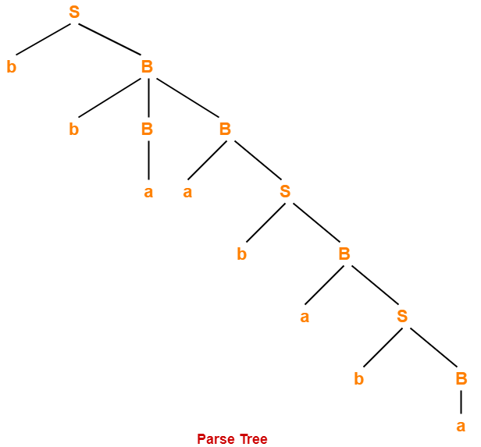

Slide 38
Example 3 :
Consider the grammar-
S → A1B
A → 0A / ∈
B → 0B / 1B / ∈
For the string w = 00101, find-
Leftmost derivation
Rightmost derivation
Parse Tree

Slide 39
Solution-
1. Leftmost Derivation-
S → A1B
→ 0A1B (Using A → 0A)
→ 00A1B (Using A → 0A)
→ 001B (Using A → ∈)
→ 0010B (Using B → 0B)
→ 00101B (Using B → 1B)
→ 00101 (Using B → ∈)
2. Rightmost Derivation-
S → A1B
→ A10B (Using B → 0B)
→ A101B (Using B → 1B)
→ A101 (Using B → ∈)
→ 0A101 (Using A → 0A)
→ 00A101 (Using A → 0A)
→ 00101 (Using A → ∈)

Slide 40
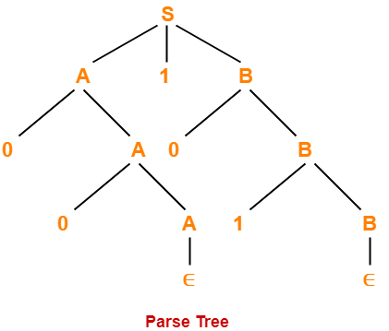
Parse Tree :

Slide 41
Example :
Let any set of production rules in a CFG be
X → X+X | X*X |X| a
over an alphabet {a}.
Show derivation for the string "a+a*a"

Slide 42
X → X+X
X→ X*X
X→X
X→ a
The leftmost derivation for the string "a+a*a" may be −
X → X+X
→ a+X
→ a + X*X
→ a+a*X
→ a+a*a

Slide 43
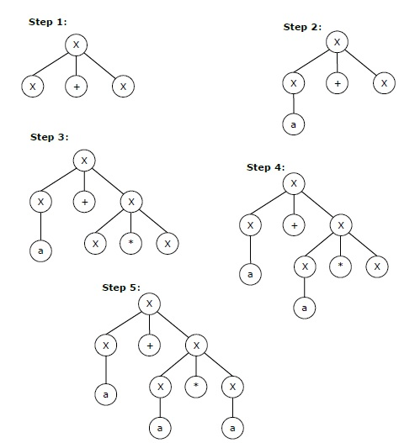
The stepwise derivation of the above string is shown as below −

Slide 44
X → X+X
X→ X*X
X→X
X→ a
The rightmost derivation for the above string "a+a*a" may be −
X → X*X
→ X*a
→ X+X*a
→ X+a*a
→ a+a*a

Slide 45
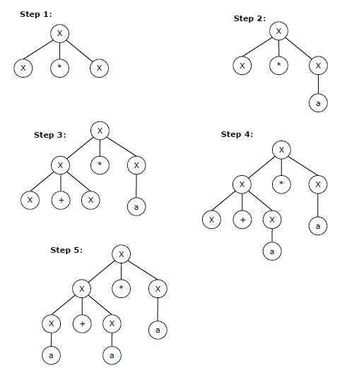
The stepwise derivation of the above string is shown as below −

